Slide 1

What is AWS?
Notes:
The goal of this module is to discover key concepts that relate to storage. You will learn about the different types of storage resources that are available and review the different pricing options so that you can understand how different choices affect your solution cost.
After completing this module, you should be able to:
Identify the different types of storage
Explain Amazon S3
Identify the functionality in Amazon S3
Explain Amazon EBS
Identify the functionality in Amazon EBS
Perform functions in Amazon EBS to build an Amazon EC2 storage solution
Explain Amazon EFS
Identify the functionality in Amazon EFS
Explain Amazon S3 Glacier
Identify the functionality in Amazon S3 Glacier
Differentiate between Amazon EBS, Amazon S3, Amazon EFS, and Amazon S3 Glacier

Slide 2
Module : Storage
AWS Academy Cloud Foundations
Section : Amazon Simple Storage Service (Amazon S3)
© 2019, Amazon Web Services, Inc. or its Affiliates. All rights reserved.
Notes:
Welcome to Module 7: Storage.

Slide 3
Module objectives
After completing this module, you should be able to:
Identify the different types of storage
Explain Amazon S3
Identify the functionality in Amazon S3
Notes:
The goal of this module is to discover key concepts that relate to storage. You will learn about the different types of storage resources that are available and review the different pricing options so that you can understand how different choices affect your solution cost.
After completing this module, you should be able to:
Identify the different types of storage
Explain Amazon S3
Identify the functionality in Amazon S3
Explain Amazon EBS
Identify the functionality in Amazon EBS
Perform functions in Amazon EBS to build an Amazon EC2 storage solution
Explain Amazon EFS
Identify the functionality in Amazon EFS
Explain Amazon S3 Glacier
Identify the functionality in Amazon S3 Glacier
Differentiate between Amazon EBS, Amazon S3, Amazon EFS, and Amazon S3 Glacier

Slide 4









Core AWS services
Amazon S3
Amazon EBS
Amazon
EFS
Amazon S3 Glacier
Amazon Virtual Private Cloud (Amazon VPC)
Amazon Elastic Compute Cloud (Amazon EC2)
AWS Identity and Access Management (IAM)
Storage
Amazon Relational
Database Service
Amazon DynamoDB
Database
Notes:
Storage is another AWS core service category. Some broad categories of storage include: instance store (ephemeral storage), Amazon EBS, Amazon EFS, Amazon S3, and Amazon S3 Glacier.
Instance store, or ephemeral storage, is temporary storage that is added to your Amazon EC2 instance.
Amazon EBS is persistent, mountable storage that can be mounted as a device to an Amazon EC2 instance. Amazon EBS can be mounted to an Amazon EC2 instance only within the same Availability Zone. Only one Amazon EC2 instance at a time can mount an Amazon EBS volume.
Amazon EFS is a shared file system that multiple Amazon EC2 instances can mount at the same time.
Amazon S3 is persistent storage where each file becomes an object and is available through a Uniform Resource Locator (URL); it can be accessed from anywhere.
Amazon S3 Glacier is for cold storage for data that is not accessed frequently (for example, when you need long-term data storage for archival or compliance reasons).

Slide 5
Section : Amazon Simple Storage Service (Amazon S3)
Module : Storage
Notes:
Introduce Section 3: Amazon Simple Storage Service.
Companies need the ability to simply and securely collect, store, and analyze their data on a massive scale. Amazon S3 is object storage that is built to store and retrieve any amount of data from anywhere: websites and mobile apps, corporate applications, and data from Internet of Things (IoT) sensors or devices.

Slide 6
Storage
Amazon Simple Storage Service (Amazon S3)
Notes:
Amazon S3 is object-level storage, which means that if you want to change a part of a file, you must make the change and then re-upload the entire modified file. Amazon S3 stores data as objects within resources that are called buckets.
You will now learn more about Amazon S3.

Slide 7


Amazon S3 overview
Data is stored as objects in buckets
Virtually unlimited storage
Single object is limited to 5 TB
Designed for 11 9s of durability
Granular access to bucket and objects
Notes:
Amazon S3 is a managed cloud storage solution that is designed to scale seamlessly and provide 11 9s of durability. You can store virtually as many objects as you want in a bucket, and you can write, read, and delete objects in your bucket. Bucket names are universal and must be unique across all existing bucket names in Amazon S3. Objects can be up to 5 TB in size. By default, data in Amazon S3 is stored redundantly across multiple facilities and multiple devices in each facility.
The data that you store in Amazon S3 is not associated with any particular server, and you do not need manage any infrastructure yourself. You can put as many objects into Amazon S3 as you want. Amazon S3 holds trillions of objects and regularly peaks at millions of requests per second.
Objects can be almost any data file, such as images, videos, or server logs. Because Amazon S3 supports objects as large as several terabytes in size, you can even store database snapshots as objects. Amazon S3 also provides low-latency access to the data over the internet by Hypertext Transfer Protocol (HTTP) or Secure HTTP (HTTPS), so you can retrieve data anytime from anywhere. You can also access Amazon S3 privately through a virtual private cloud (VPC) endpoint. You get fine-grained control over who can access your data by using AWS Identity and Access Management (IAM) policies, Amazon S3 bucket policies, and even per-object access control lists.
By default, none of your data is shared publicly. You can also encrypt your data in transit and choose to enable server-side encryption on your objects.
You can access Amazon S3 through the web-based AWS Management Console; programmatically through the API and SDKs; or with third-party solutions, which use the API or the SDKs.
Amazon S3 includes event notifications that enable you to set up automatic notifications when certain events occur, such as when an object is uploaded to a bucket or deleted from a specific bucket. Those notifications can be sent to you, or they can be used to trigger other processes, such as AWS Lambda functions.
With storage class analysis, you can analyze storage access patterns and transition the right data to the right storage class. The Amazon S3 Analytics feature automatically identifies the optimal lifecycle policy to transition less frequently accessed storage to Amazon S3 Standard – Infrequent Access (Amazon S3 Standard-IA). You can configure a storage class analysis policy to monitor an entire bucket, a prefix, or an object tag.
When an infrequent access pattern is observed, you can easily create a new lifecycle age policy that is based on the results. Storage class analysis also provides daily visualizations of your storage usage in the AWS Management Console. You can export them to an Amazon S3 bucket to analyze by using the business intelligence (BI) tools of your choice, such as Amazon QuickSight.

Slide 8
Amazon S3 storage classes
Amazon S3 offers a range of object-level storage classes that are designed for different use cases:
Amazon S3 Standard
Amazon S3 Intelligent-Tiering
Amazon S3 Standard-Infrequent Access (Amazon S3 Standard-IA)
Amazon S3 One Zone-Infrequent Access (Amazon S3 One Zone-IA)
Amazon S3 Glacier
Amazon S3 Glacier Deep Archive
For more information see, Amazon S3 storage classes.
Notes:
Amazon S3 offers a range of object-level storage classes that are designed for different use cases. These classes include:
Amazon S3 Standard – Amazon S3 Standard is designed for high durability, availability, and performance object storage for frequently accessed data. Because it delivers low latency and high throughput, Amazon S3 Standard is appropriate for a variety of use cases, including cloud applications, dynamic websites, content distribution, mobile and gaming applications, and big data analytics.
Amazon S3 Intelligent-Tiering – The Amazon S3 Intelligent-Tiering storage class is designed to optimize costs by automatically moving data to the most cost-effective access tier, without performance impact or operational overhead. For a small monthly monitoring and automation fee per object, Amazon S3 monitors access patterns of the objects in Amazon S3 Intelligent-Tiering, and moves the objects that have not been accessed for 30 consecutive days to the infrequent access tier. If an object in the infrequent access tier is accessed, it is automatically moved back to the frequent access tier. There are no retrieval fees when you use the Amazon S3 Intelligent-Tiering storage class, and no additional fees when objects are moved between access tiers. It works well for long-lived data with access patterns that are unknown or unpredictable.
Amazon S3 Standard-Infrequent Access (Amazon S3 Standard-IA) – The Amazon S3 Standard-IA storage class is used for data that is accessed less frequently, but requires rapid access when needed. Amazon S3 Standard-IA is designed to provide the high durability, high throughput, and low latency of Amazon S3 Standard, with a low per-GB storage price and per-GB retrieval fee. This combination of low cost and high performance makes Amazon S3 Standard-IA good for long-term storage and backups, and as a data store for disaster recovery files.
Amazon S3 One Zone-Infrequent Access (Amazon S3 One Zone-IA) – Amazon S3 One Zone-IA is for data that is accessed less frequently, but requires rapid access when needed. Unlike other Amazon S3 storage classes, which store data in a minimum of three Availability Zones, Amazon S3 One Zone-IA stores data in a single Availability Zone and it costs less than Amazon S3 Standard-IA. Amazon S3 One Zone-IA works well for customers who want a lower-cost option for infrequently accessed data, but do not require the availability and resilience of Amazon S3 Standard or Amazon S3 Standard-IA. It is a good choice for storing secondary backup copies of on-premises data or easily re-creatable data. You can also use it as cost-effective storage for data that is replicated from another AWS Region by using Amazon S3 Cross-Region Replication.
Amazon S3 Glacier – Amazon S3 Glacier is a secure, durable, and low-cost storage class for data archiving. You can reliably store any amount of data at costs that are competitive with—or cheaper than—on-premises solutions. To keep costs low yet suitable for varying needs, Amazon S3 Glacier provides three retrieval options that range from a few minutes to hours. You can upload objects directly to Amazon S3 Glacier, or use Amazon S3 lifecycle policies to transfer data between any of the Amazon S3 storage classes for active data (Amazon S3 Standard, Amazon S3 Intelligent-Tiering, Amazon S3 Standard-IA, and Amazon S3 One Zone-IA) and Amazon S3 Glacier.
Amazon S3 Glacier Deep Archive – Amazon S3 Glacier Deep Archive is the lowest-cost storage class for Amazon S3. It supports long-term retention and digital preservation for data that might be accessed once or twice in a year. It is designed for customers — particularly customers in highly regulated industries, such as financial services, healthcare, and public sectors — that retain datasets for 7–10 years (or more) to meet regulatory compliance requirements. Amazon S3 Glacier Deep Archive can also be used for backup and disaster recovery use cases. It is a cost-effective and easy-to-manage alternative to magnetic tape systems, whether these tape systems are on-premises libraries or off-premises services. Amazon S3 Glacier Deep Archive complements Amazon S3 Glacier, and it is also designed to provide 11 9s of durability. All objects that are stored in Amazon S3 Glacier Deep Archive are replicated and stored across at least three geographically dispersed Availability Zones, and these objects can be restored within 12 hours.
For more information see, Amazon S3 storage classes.

Slide 9


Amazon S3 bucket URLs (two styles)
Amazon S3
To upload your data:
Create a bucket in an AWS Region.
Upload almost any number of objects to the bucket.
Bucket path-style URL endpoint:
[bucket name]
https://s3.ap-northeast-1.amazonaws.com/bucket-name
Region code
Bucket name
Bucket virtual hosted-style URL endpoint:
Preview2.mp4
https:// bucket-name.s3-ap-northeast-1.amazonaws.com
Tokyo Region (ap-northeast-1)
Bucket name
Region code
Notes:
To use Amazon S3 effectively, you must understand a few simple concepts. First, Amazon S3 stores data inside buckets. Buckets are essentially the prefix for a set of files, and must be uniquely named across all of Amazon S3 globally. Buckets are logical containers for objects. You can have one or more buckets in your account. You can control access for each bucket—who can create, delete, and list objects in the bucket. You can also view access logs for the bucket and its objects, and choose the geographical region where Amazon S3 stores the bucket and its contents.
To upload your data (such as photos, videos, or documents), create a bucket in an AWS Region, and then upload almost any number of objects to the bucket.
In the example, Amazon S3 was used to create a bucket in the Tokyo Region, which is identified within AWS formally by its Region code: ap-northeast-1
The URL for a bucket is structured like the examples. You can use two different URL styles to refer to buckets.
Amazon S3 refers to files as objects. As soon as you have a bucket, you can store almost any number of objects inside it. An object is composed of data and any metadata that describes that file, including a URL. To store an object in Amazon S3, you upload the file that you want to store to a bucket.
When you upload a file, you can set permissions on the data and any metadata.
In this example, the object Preview2.mp4 is stored inside the bucket. The URL for the file includes the object name at the end.

Slide 10


Data is redundantly stored in the Region
media/welcome.mp4
Facility 1
Facility 2
Facility 3
my-bucket-name
Region
Notes:
When you create a bucket in Amazon S3, it is associated with a specific AWS Region. When you store data in the bucket, it is redundantly stored across multiple AWS facilities within your selected Region.
Amazon S3 is designed to durably store your data, even if there is concurrent data loss in two AWS facilities.

Slide 11

Designed for seamless scaling
media/welcome.mp4
prod2.mp4
prod3.mp4
prod4.mp4
prod5.mp4
prod6.mp4
prod7.mp4
prod8.mp4
my-bucket-name
prod9.mp4
prod10.mp4
prod11.mp4
prod12.mp4
Notes:
Amazon S3 automatically manages the storage behind your bucket while your data grows. You can get started immediately, and your data storage will grow with your application needs.
Amazon S3 also scales to handle a high volume of requests. You do not need to provision the storage or throughput, and you are billed only for what you use.

Slide 12



Access the data anywhere
AWS Management Console
AWS Command Line Interface
SDK
Notes:
You can access Amazon S3 through the console, AWS Command Line Interface (AWS CLI), or AWS SDK. You can also access the data in your bucket directly by using REST-based endpoints.
The endpoints support HTTP or HTTPS access. To support this type of URL-based access, Amazon S3 bucket names must be globally unique and Domain Name Server (DNS)-compliant.
Also, object keys should use characters that are safe for URLs.

Slide 13

Common use cases
Storing application assets
Static web hosting
Backup and disaster recovery (DR)
Staging area for big data
Many more….
Notes:
This flexibility to store a virtually unlimited amount of data—and to access that data from anywhere—means that Amazon S3 is suitable for a variety of scenarios. You will now consider some use cases for Amazon S3:
As a location for any application data, Amazon S3 buckets provide a shared location for storing objects that any instances of your application can access—including applications on Amazon EC2 or even traditional servers. This feature can be useful for user-generated media files, server logs, or other files that your application must store in a common location. Also, because the content can be fetched directly over the internet, you can offload serving that content from your application and enable clients to directly fetch the data from Amazon S3 themselves.
For static web hosting, Amazon S3 buckets can serve the static contents of your website, including HTML, CSS, JavaScript, and other files.
The high durability of Amazon S3 makes it a good candidate for storing backups of your data. For greater availability and disaster recovery capability, Amazon S3 can even be configured to support cross-Region replication so that data in an Amazon S3 bucket in one Region can be automatically replicated to another Amazon S3 Region.

Slide 14

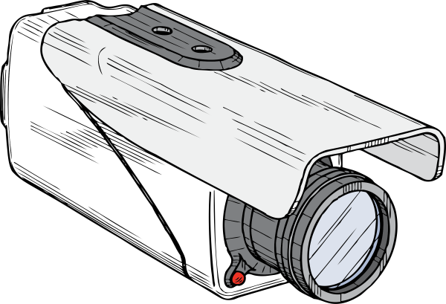



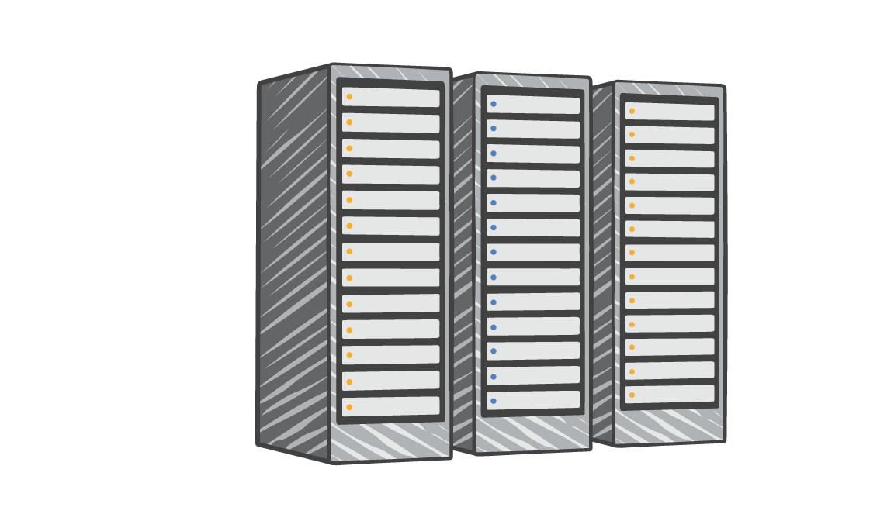
Amazon S3 common scenarios
Backup and storage
Application hosting
Media hosting
Software delivery
Amazon S3 buckets
Corporate data center
Amazon EC2 instances
Notes:
Backup and storage – Provide data backup and storage services for others
Application hosting – Provide services that deploy, install, and manage web applications
Media hosting – Build a redundant, scalable, and highly available infrastructure that hosts video, photo, or music uploads and downloads
Software delivery – Host your software applications that customers can download

Slide 15
Amazon S3 pricing
Pay only for what you use, including –
GBs per month
Transfer OUT to other Regions
PUT, COPY, POST, LIST, and GET requests
You do not pay for –
Transfers IN to Amazon S3
Transfers OUT from Amazon S3 to Amazon CloudFront or Amazon EC2 in the same Region
Notes:
With Amazon S3, specific costs vary depending on the Region and the specific requests that were made. You pay only for what you use, including gigabytes per month; transfer out of other Regions; and PUT, COPY, POST, LIST, and GET requests. As a general rule, you pay only for transfers that cross the boundary of your Region, which means you do not pay for transfers in to Amazon S3 or transfers out from Amazon S3 to Amazon CloudFront edge locations within that same Region.

Slide 16
Amazon S3: Storage pricing
To estimate Amazon S3 costs, consider the following:
Storage class type –
Standard storage is designed for:
11 9s of durability
Four 9s of availability
S3 Standard-Infrequent Access (S-IA) is designed for:
11 9s of durability
Three 9s of availability
Amount of storage –
The number and size of objects
Notes:
When you begin to estimate the costs of Amazon S3, you must consider the following:
Storage class type –
Standard storage is designed to provide 11 9s of durability and four 9s of availability.
S3 Standard – Infrequent Access (S-IA) is a storage option within Amazon S3 that you can use to reduce your costs by storing less frequently accessed data at slightly lower levels of redundancy than Amazon S3 standard storage. Standard – Infrequent Access is designed to provide the same 11 9s of durability as Amazon S3, with three 9s of availability in a given year. Each class has different rates.
Amount of storage – The number and size of objects stored in your Amazon S3 buckets.

Slide 17
Amazon S3: Storage pricing
Requests –
The number and type of requests (GET, PUT, COPY)
Type of requests:
Different rates for GET requests than other requests.
Data transfer –
Pricing is based on the amount of data that is transferred out of the Amazon S3 Region
Data transfer in is free, but you incur charges for data that is transferred out.
Notes:
Requests – Consider the number and type of requests. GET requests incur charges at different rates than other requests, such as PUT and COPY requests.
GET – Retrieves an object from Amazon S3. You must have READ access to use this operation.
PUT – Adds an object to a bucket. You must have WRITE permissions on a bucket to add an object to it.
COPY – Creates a copy of an object that is already stored in Amazon S3. A COPY operation is the same as performing a GET and then a PUT.
Data transfer – Consider the amount of data that is transferred out of the Amazon S3 Region. Remember that data transfer in is free, but there is a charge for data transfer out.

Slide 18

Section key takeaways
Amazon S3 is a fully managed cloud storage service.
You can store a virtually unlimited number of objects.
You pay for only what you use.
You can access Amazon S3 at any time from anywhere through a URL.
Amazon S3 offers rich security controls.
Notes:
You have completed an introduction to Amazon S3, including key features and some common use cases.
To learn more about Amazon S3, see Amazon S3.

Slide 19




Amazon Simple Storage Service (S3)
What is Amazon Simple Storage Service?
Amazon S3 uses the following ways for security: User-based security
IAM policies
Resource-Based
Amazon S3 is a simple service used to provide key-based object storage across multiple availability zones (AZs) in a specific region.
S3 is a global service with region-specific buckets.
It is also termed a static website hosting service.
It provides 99.999999999% (11 9's) of content durability.
S3 offers strong read-after-write consistency for any object.
Objects (files) are stored in a region-specific container known as Bucket.
Objects that are stored can range from 0 bytes - 5TB.
Amazon S3
Bucket Policies
Bucket Access Control List (ACL)
Object Access Control List (ACL)
Amazon S3 provides the following storage classes used to maintain the integrity
of the objects:
S3 Standard - offers frequent data access.
S3 Intelligent-Tiering - automatically transfer data to other cost-effective access tiers.
S3 Standard-IA - offers immediate and infrequent data access.
S3 One Zone-IA - infrequent data access.
S3 Glacier - long-term archive data, cheap data retrieval.
S3 Glacier Deep Archive - used for long-term retention.
It provides ‘Multipart upload’ features that upload objects in parts, suitable
for 100 MB or larger objects.
It offers to choose ‘Versioning ’ features to retain multiple versions of
objects, must enable versioning at both source and destination.
Amazon S3 Transfer Acceleration allows fast and secure transfer of objects over long distances with minimum latency using Amazon CloudFront’s Edge Locations.
Amazon S3 uses access control lists (ACL) to control access to the objects and buckets.
Amazon S3 provides Cross-Account access to the objects and buckets by assuming a role with specified privileges.
Amazon S3 offers to choose from the following ways to replicate objects:
Cross-Region Replication - used to replicate objects in different AWS Regions.
Same Region Replication - used to replicate objects in the same AWS Region.
Notes:
This card is produced by the WHIZLABS. For the latest version, please visit https://www.whizlabs.com/.

Slide 20

What is Big Data?
Notes:
The goal of this module is to discover key concepts that relate to storage. You will learn about the different types of storage resources that are available and review the different pricing options so that you can understand how different choices affect your solution cost.
After completing this module, you should be able to:
Identify the different types of storage
Explain Amazon S3
Identify the functionality in Amazon S3
Explain Amazon EBS
Identify the functionality in Amazon EBS
Perform functions in Amazon EBS to build an Amazon EC2 storage solution
Explain Amazon EFS
Identify the functionality in Amazon EFS
Explain Amazon S3 Glacier
Identify the functionality in Amazon S3 Glacier
Differentiate between Amazon EBS, Amazon S3, Amazon EFS, and Amazon S3 Glacier

Slide 21
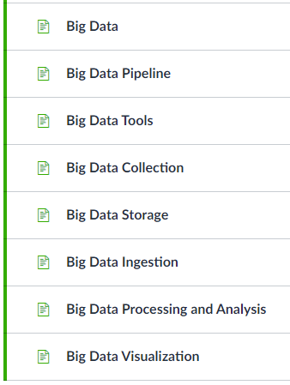
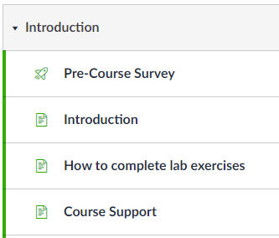
AWS Academy Data Analytics
How to complete lab exercise?
Notes:
Look at the answer choices and rule them out based on the keywords that were previously highlighted.

Slide 22
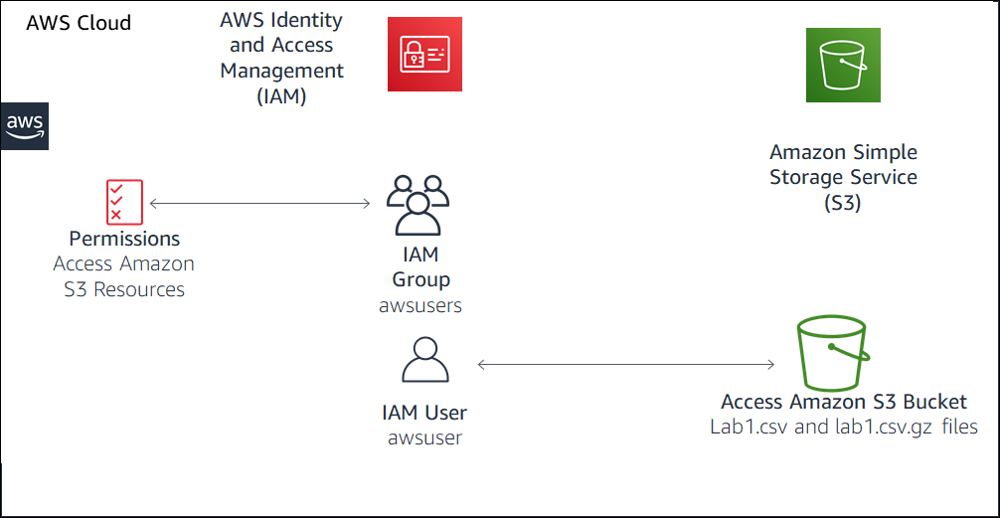
Lab 1: Store Data in Amazon Simple Storage Service (Amazon S3)
Lab introduction:
Overview of Amazon Simple StorageService (Amazon S3)
Task 1: Add an AWS Identity and Access Management (IAM) account to a group
Task 2: Load data into Amazon S3
Task 3: Query data in Amazon S3

Slide 23
AWS S3 Select Command https://docs.aws.amazon.com/AmazonS3/latest/userguide/s3-glacier-select-sql-reference-select.html
Amazon S3 Select and S3 Glacier Select support only the SELECT SQL command. The following ANSI standard clauses are supported for SELECT:
SELECT list
SELECT *
SELECT projection [ AS column_alias | column_alias ] [, ...]
FROM clause
FROM table_name
FROM table_name alias
FROM table_name AS alias
WHERE clause
WHERE condition
LIMIT clause (Amazon S3 Select only)
LIMIT number
For example, the following query is to count the total number of column 1 equal to ‘1’:
SELECT COUNT (s._1) FROM s3Object s WHERE s._1 = '1';

Slide 24

Notes:
Thanks for participating!

